Slide 1
Predicting Median General Practitioner (GP) Earnings
Dev Makwana, Anirudh Chintaluri

Slide 2
Project Statement
The purpose of this project is to create a model to predict the median income (before tax) of general practitioners (GPs) in the United Kingdom.
This can be used to better understand the circumstances for GPs in specific demographics, and can be used to make better healthcare policy-making decisions from governments and healthcare firms, as well as using it as a metric for economic forecasting, the job market, and general quality of life.
Notes:
Dev

Slide 3
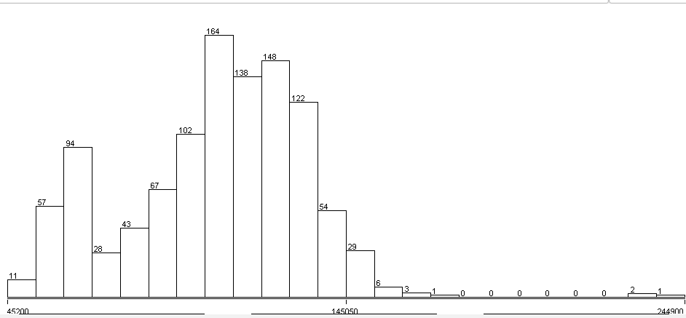
Description of the Dataset
Single dataset from the National Health Service England Website
55 attributes, one class attribute, and 1406 instances (before preprocessing).
Notes:
Dev

Slide 4
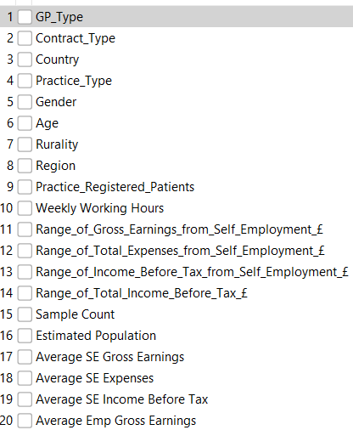
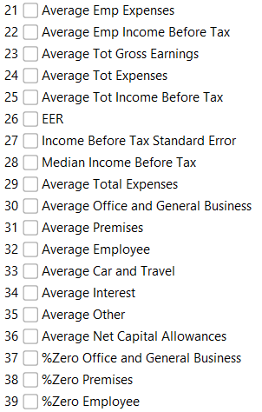
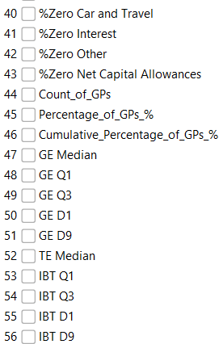
Description of the Dataset
Notes:
Dev

Slide 5
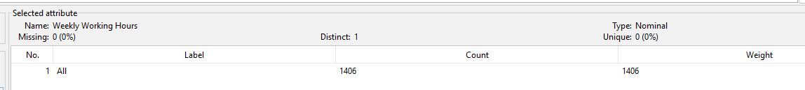
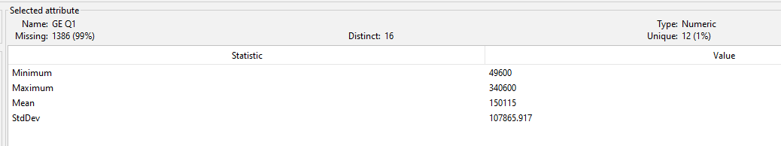
Pre-Processing
The following were the steps we took for pre-processing the data:
Remove any instances missing the class value
Remove unnecessary attributes
Removing attributes with too many missing values
Notes:
Dev

Slide 6
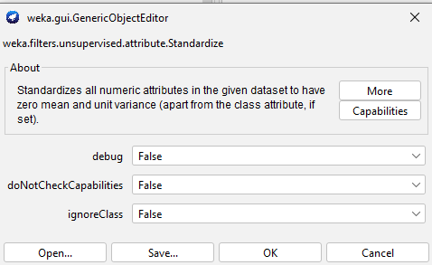
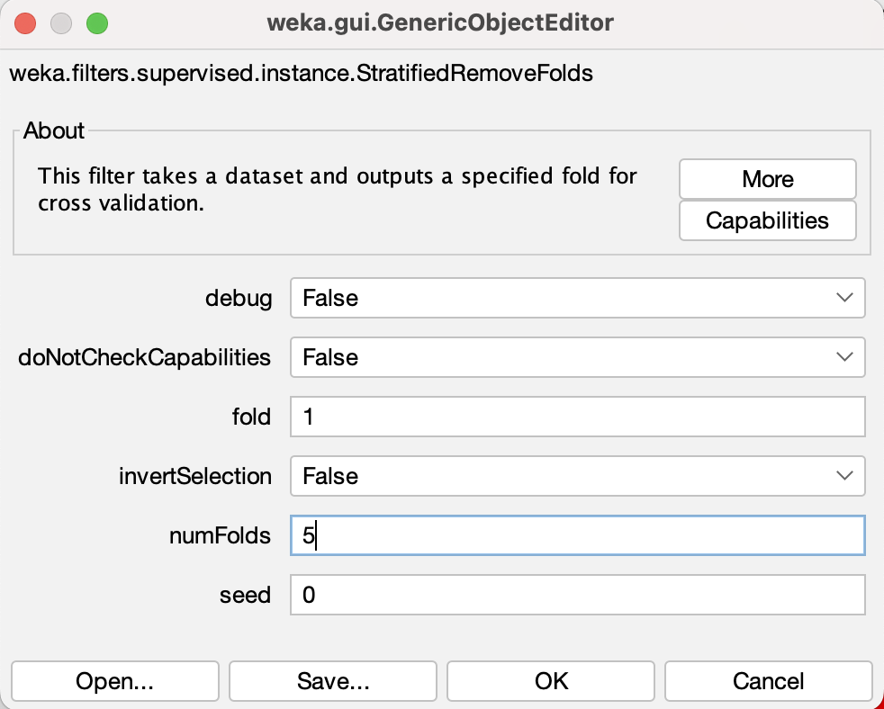
Pre-Processing
3. Removing attributes too similar to class
Average Tot Gross Earnings
Average Tot Income Before Tax
Income Before Tax Standard Error
4. Normalize the data
Using Standardize to normalize by z-score
5. Split the dataset into training and testing datasets with Stratified Random Sampling
80% for training, 20% for testing
invertSelection = True for training
Notes:
Dev

Slide 7
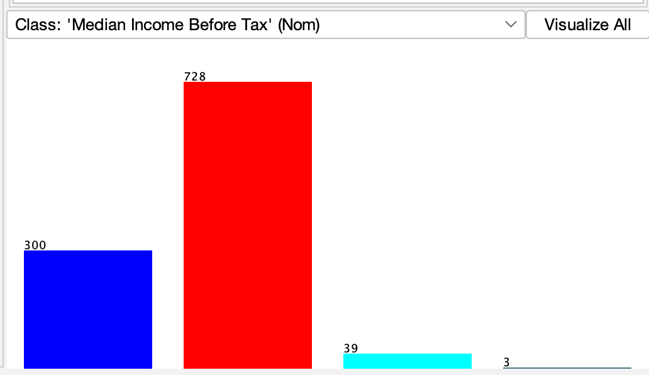
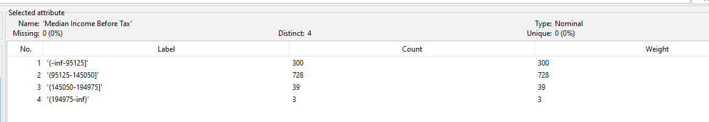
Discretization of Class
Converted the class to a nominal data type by discretizing it into four bins of equal width.
Notes:
Dev

Slide 8
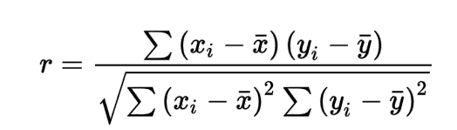
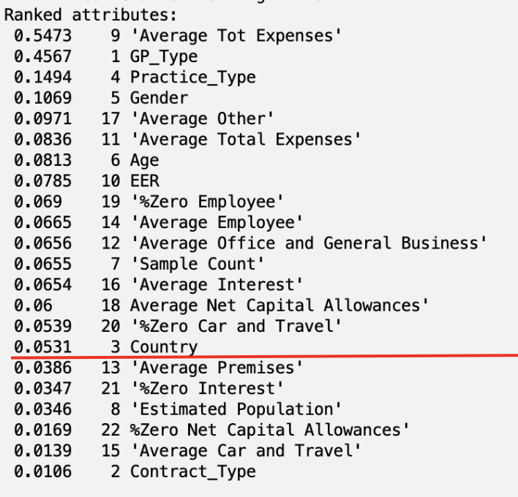
Attribute Selection Algorithms: Correlation
Finds the Pearson correlation coefficient for each attribute
Attributes with a correlation coefficient below 0.05 were removed. (Removed 7 attributes)
Notes:
Dev

Slide 9
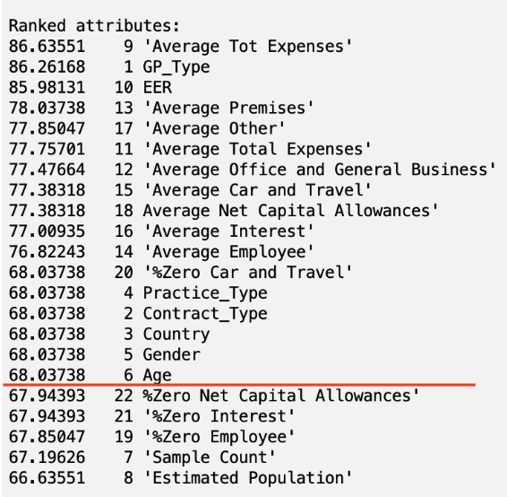
Attribute Selection Algorithm: OneR
Creates a rule to predict the class using a single attribute. Finds the rule with the lowest error rate using the pseudocode below.
For each attribute
For each unique value of the attribute
count the frequency of each class value
find the most frequent class value
make rule where the most frequent class value is assigned to this value of the attribute
Calculate the error rate of each rule for this attribute
Choose the rule with the lowest error rate
Attributes with a score of less than 68.0 were removed. (Removed 6 attributes)
Notes:
Dev

Slide 10
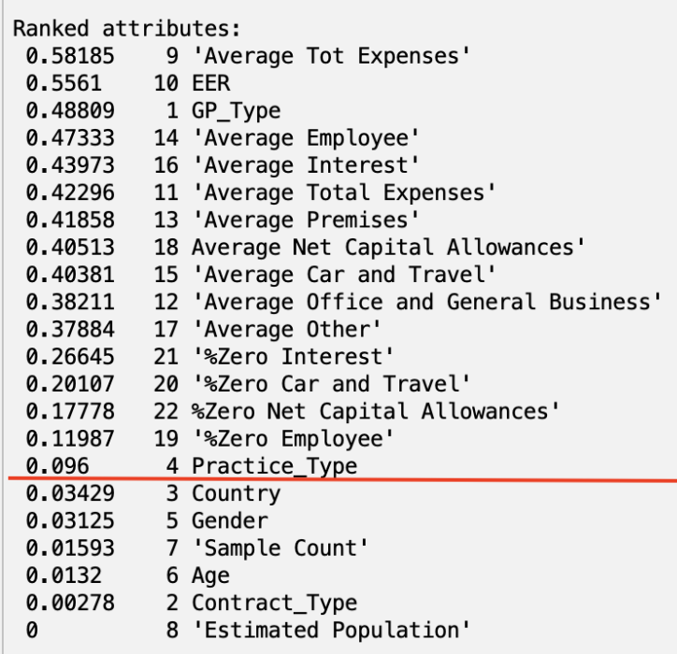

Attribute Selection Algorithm: Info Gain
Uses the following formulas to calculate Gain(A) for each attribute A
where m is the number of classes and p_{i} is the probability that a tuple in dataset D belongs to C_{i}, estimated by taking the ratio of the number of tuples in D where the class is C_{i} to the total number of tuples in D. Attributes with an information gain value below 0.05 were removed.
Notes:
Dev

Slide 11
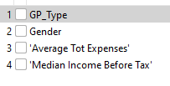
Attribute Selection Algorithm: Cfs Subset
Evaluates the worth of a different subsets of attributes, using the GreedyStepwise to find the best subset.
Below is the best subset found
Notes:
Dev

Slide 12
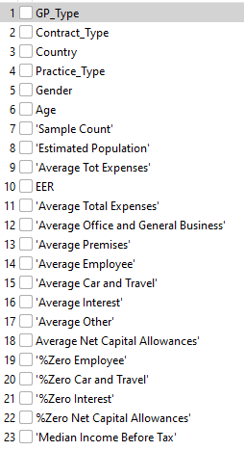
Attribute Selection Algorithm: Hand-Picked

Slide 13
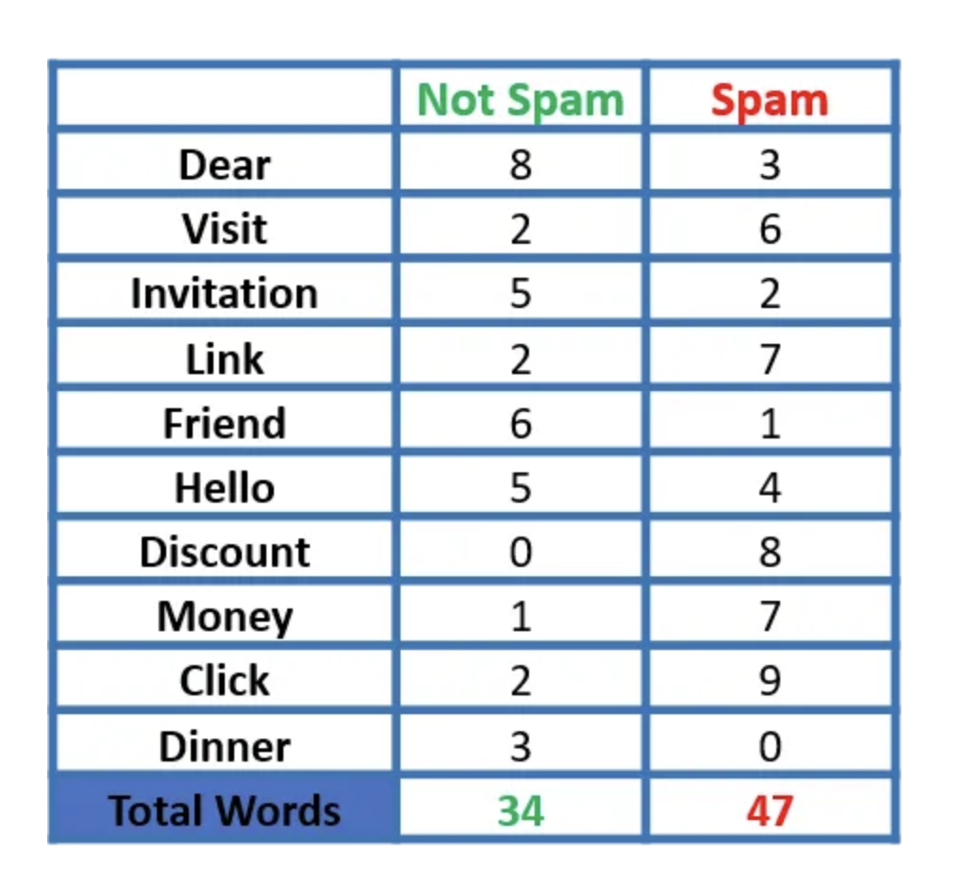


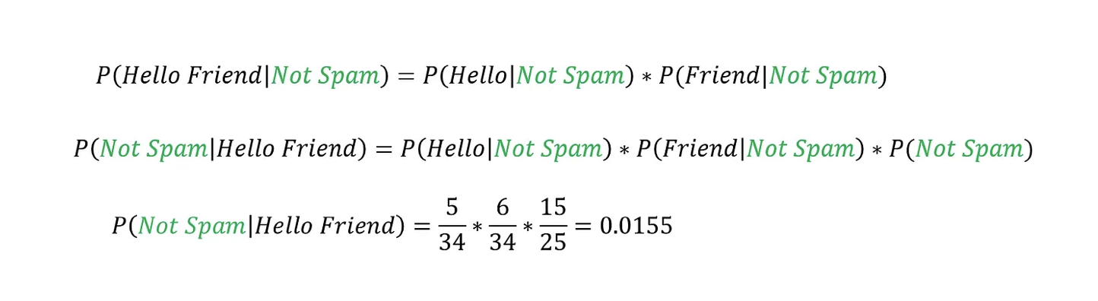
Classifier Model: Naive Bayes
Calculates probabilities using Bayes’ Theorem
Assumes the features we use to predict the target are independent
The class with the highest probability becomes the model’s prediction
Notes:
Anirudh

Slide 14
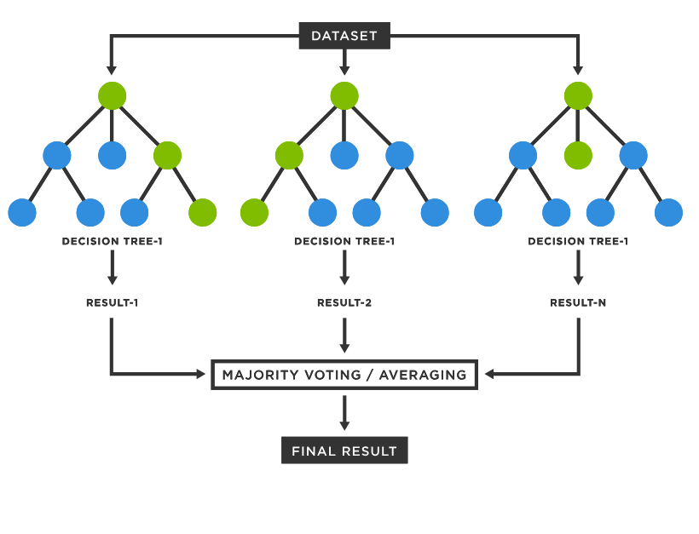
Classifier Model: Random Forest
Voting-based model
Creates multiple decision trees to determine class prediction
Class with highest number of trees “votes” becomes the model’s prediction
All of the trees are equally weighted for this process.
Notes:
Anirudh

Slide 15
Classifier Model: OneR
This works the same as the OneR attribute selection algorithm.
For each attribute
For each unique value of the attribute
count the frequency of each class value
find the most frequent class value
make rule where the most frequent class value is assigned to this value of the attribute
Calculate the error rate of each rule for this attribute
Choose the rule with the lowest error rate
Notes:
Anirudh

Slide 16
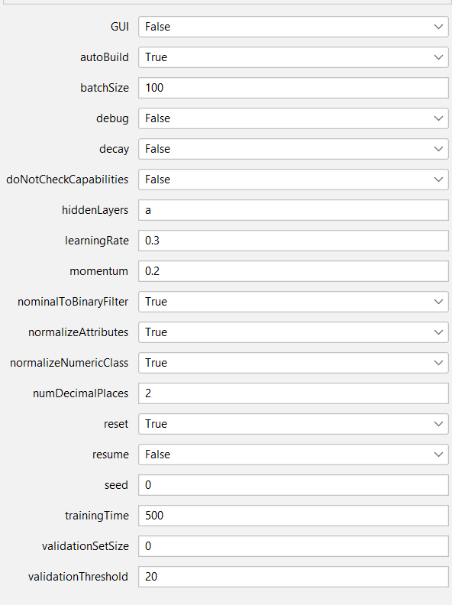
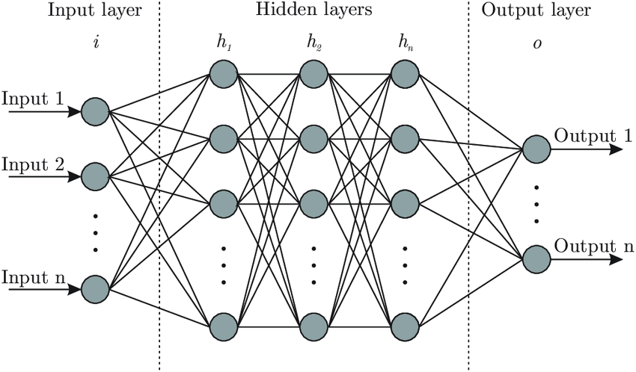
Classifier Model: Multilayer Perceptron
Simplistic Neural Network
Trained through gradient descent, backpropagation
Notes:
Anirudh

Slide 17
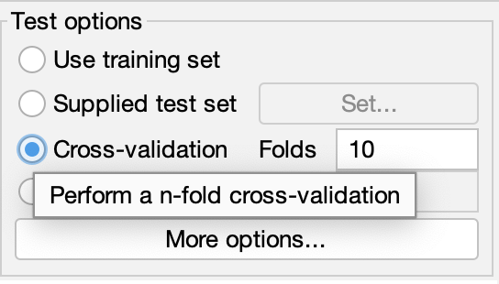
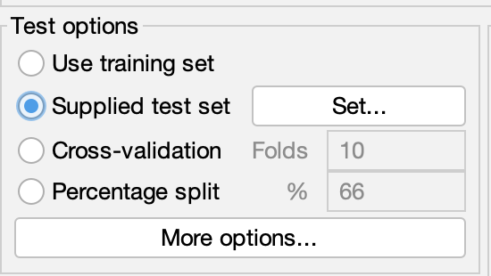
Measuring Performance
Training: 10-fold cross-validation
No need for validation set
Testing: Supplied Test Set
Notes:
Anirudh

Slide 18
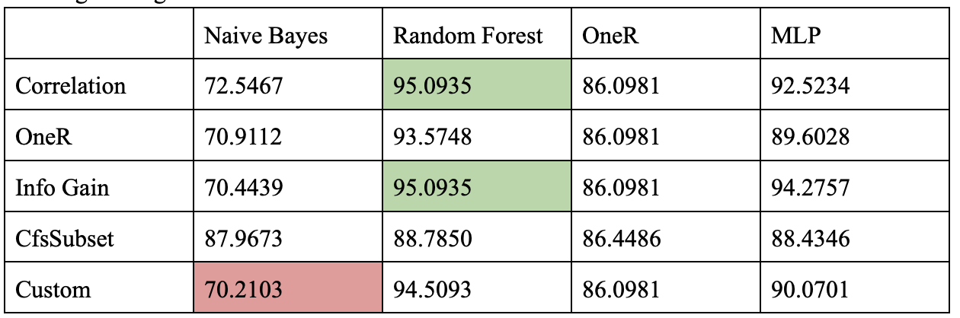
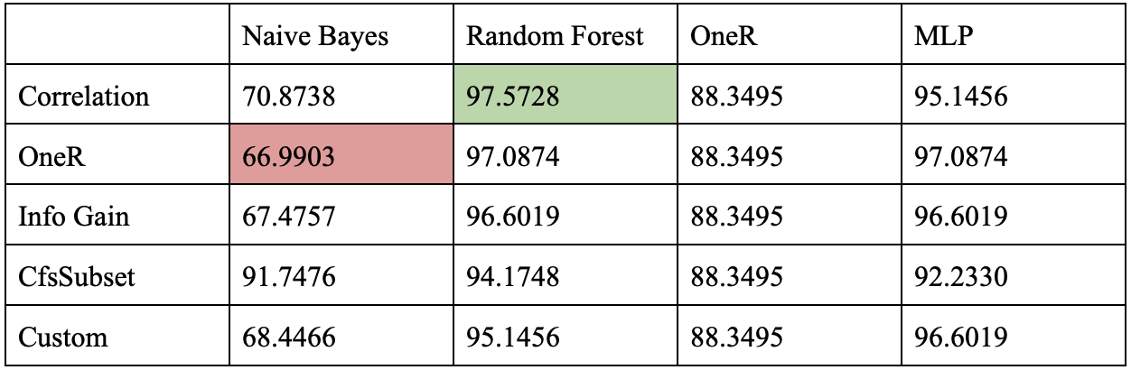
Results - Accuracy
Training, cross-validation
Testing, testing dataset
Notes:
Anirudh

Slide 19
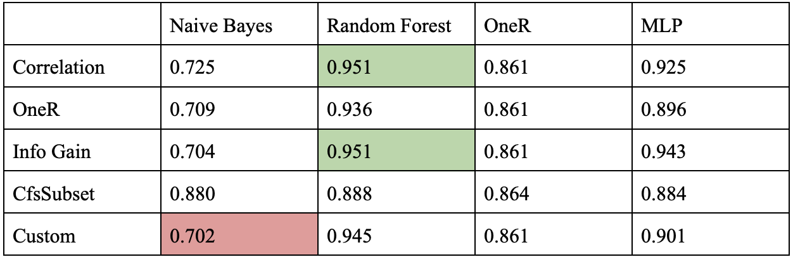
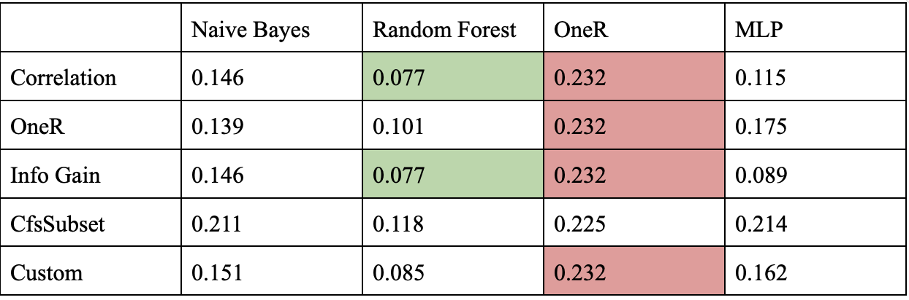
Results - TPR, FPR
True Positive Rate (TPR)
False Positive Rate (FPR)

Slide 20
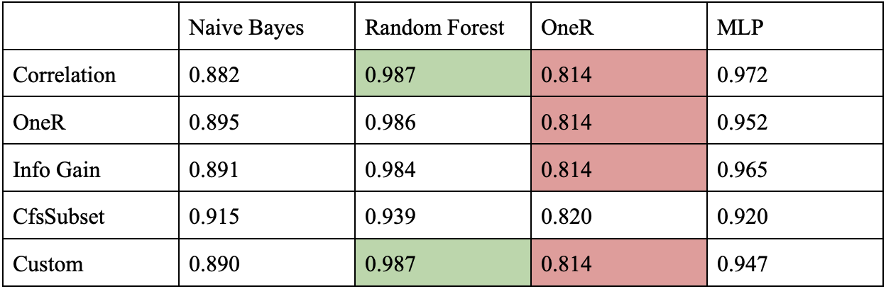
Results - ROC Area

Slide 21
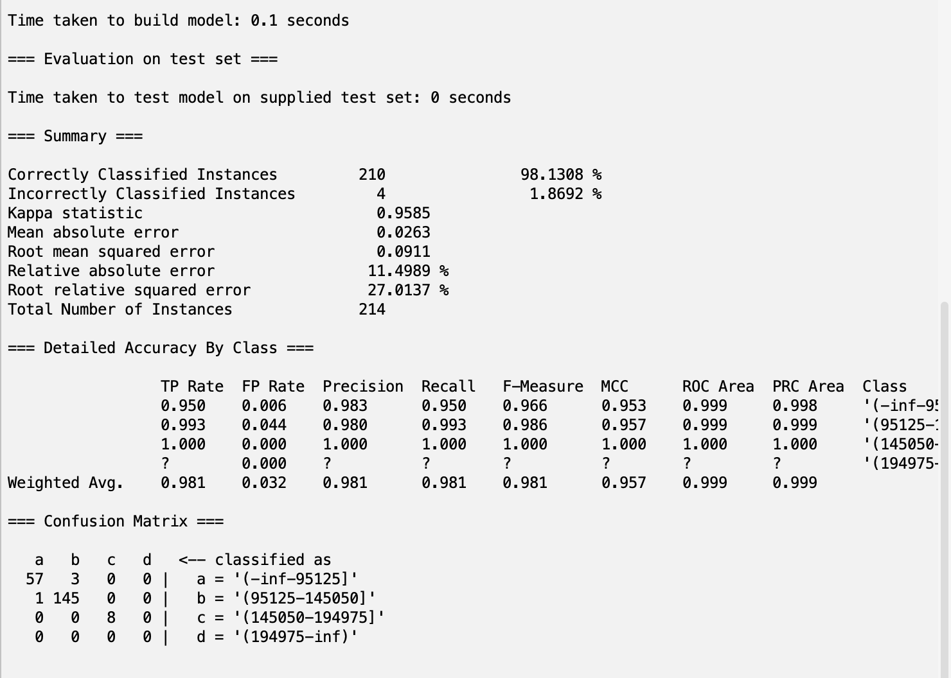
Results
Notes:
Anirudh

Slide 22
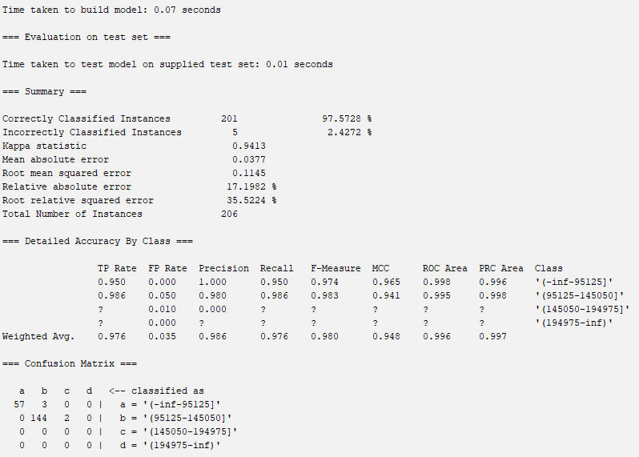
Analysis
Pearson Correlation approach most effective attribute selection algorithm
Random Forest most effective model
Scores ranged from 66.9903% to 97.5728%
Chose Correlation-RandomForest as our model with the highest accuracy, the lowest error rates of all models, highest TP, lowest FP, and near perfect ROC area.
Testing accuracy scores inflated
Notes:
Anirudh

Slide 23
Conclusion
We were able to successfully train machine learning models to predict salary of GPs based on demographics
All models achieved at least 65% accuracy
Highest performing model: Correlation-RandomForest - 97.5728% accuracy
Limitations:
Last class bin not represented well in the test set (3 total instances)
Future Directions:
Collect more data such that those of the highest income batch are represented well in the dataset
SMOTE as an alternative
Enables policy-makers to make better decisions for development of society
Notes:
Anirudh

